Slide 1
Продукты
FOODS

Slide 2
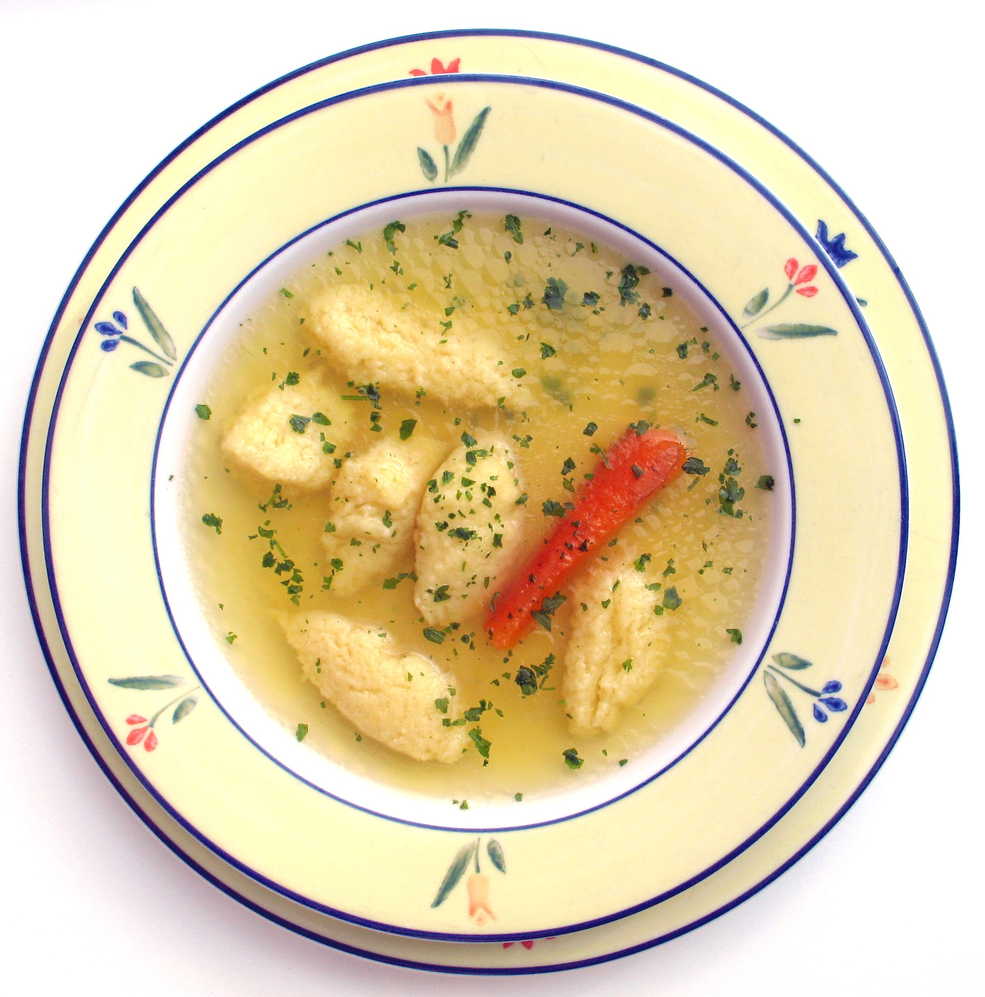
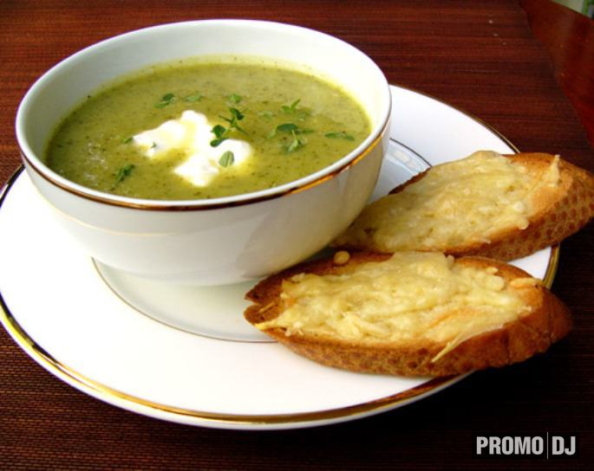
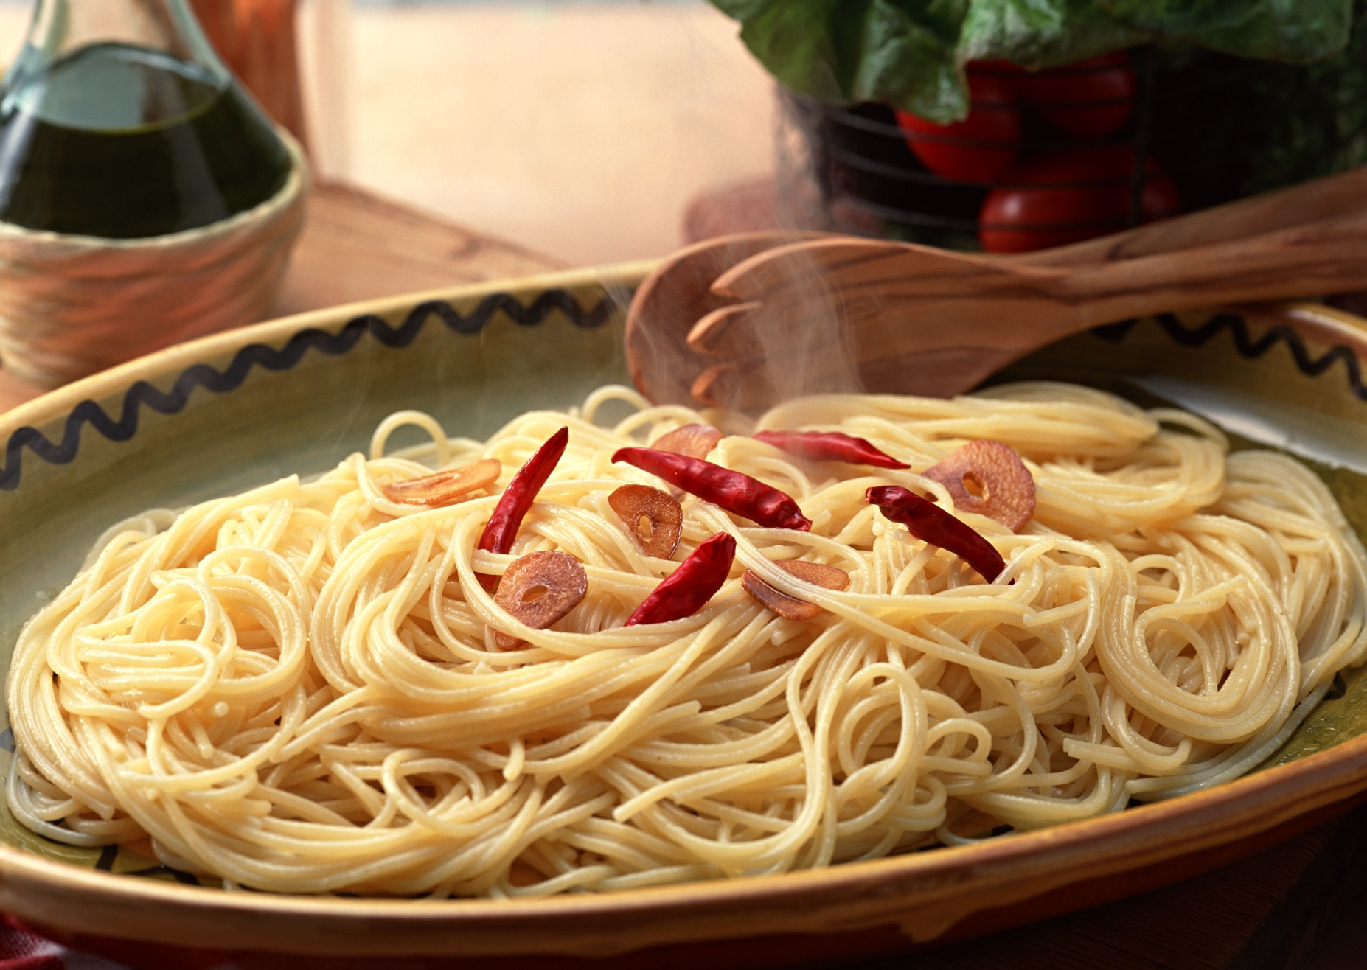
soup
soup
spaghetti

Slide 3
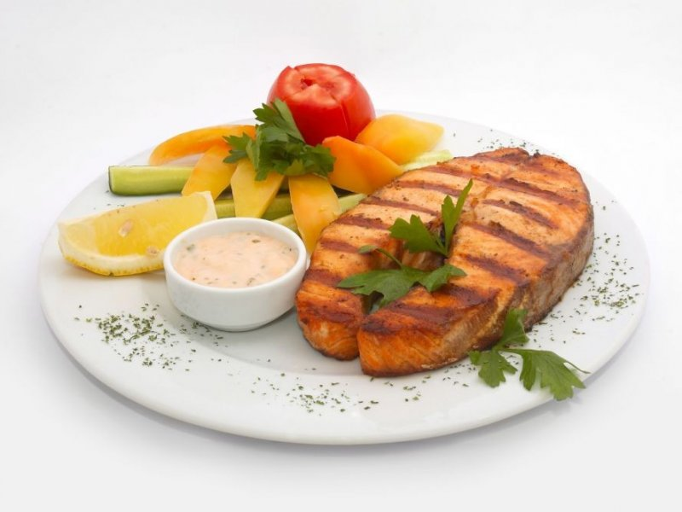
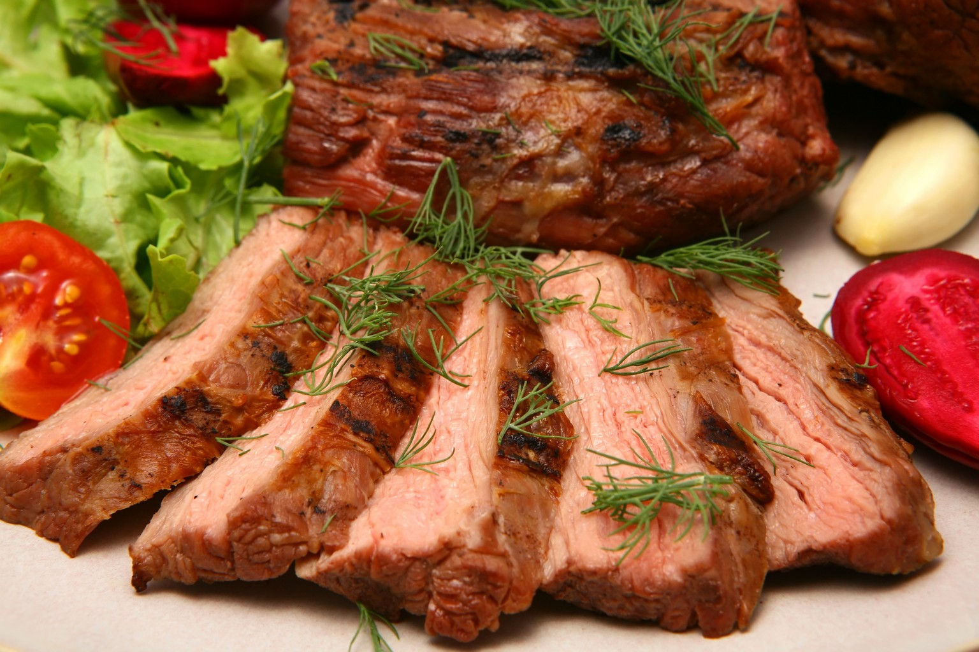
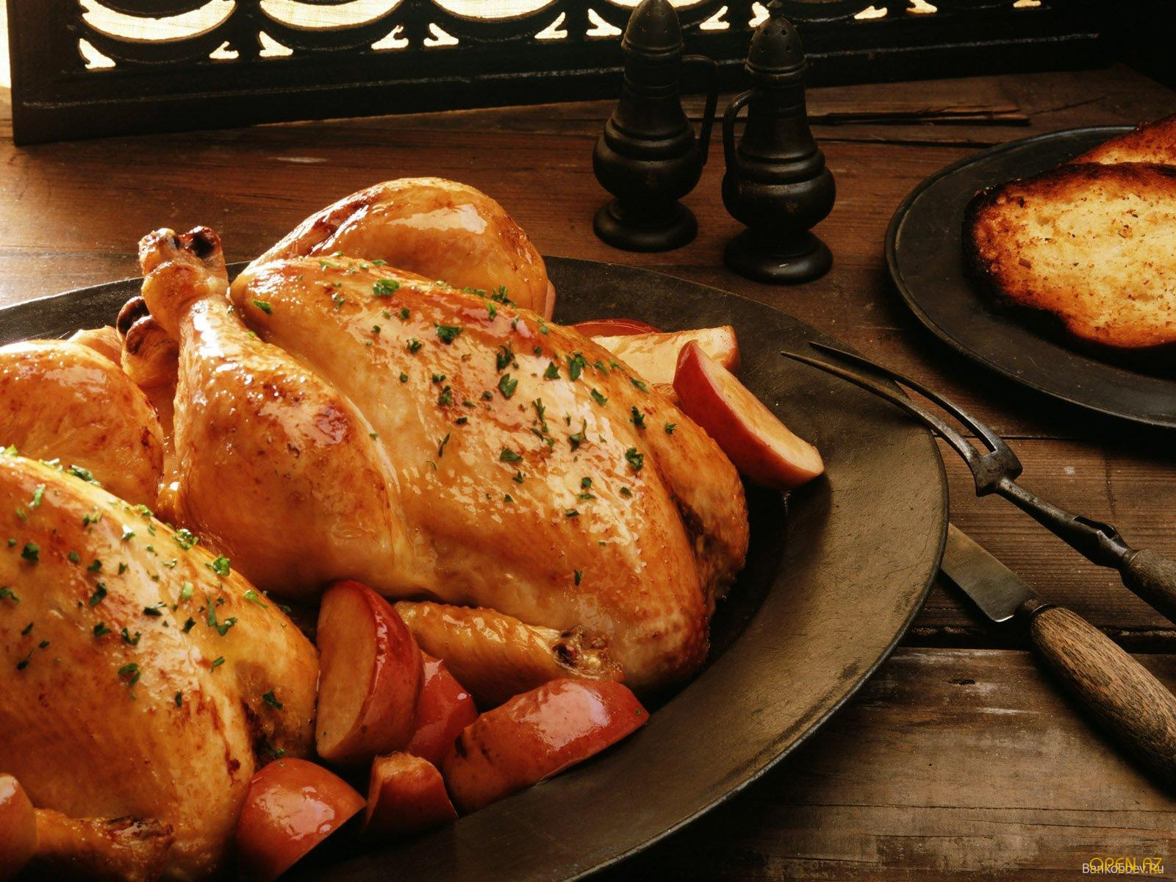
fish
meat
chicken

Slide 4
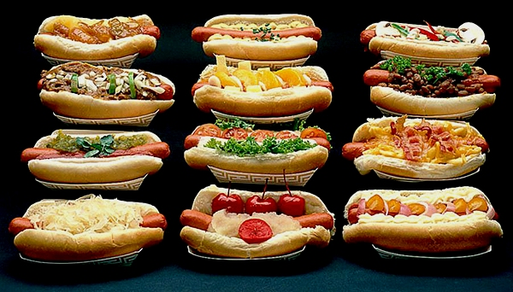
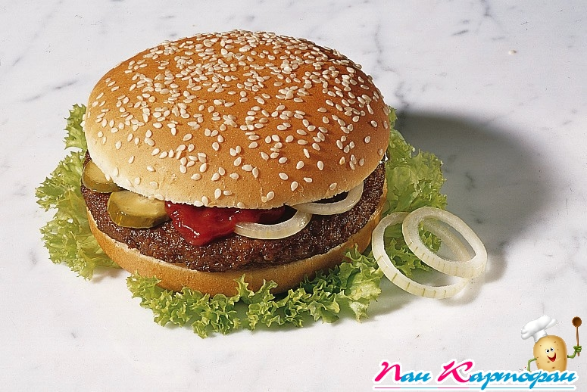
hotdogs
hamburger
hotdog

Slide 5
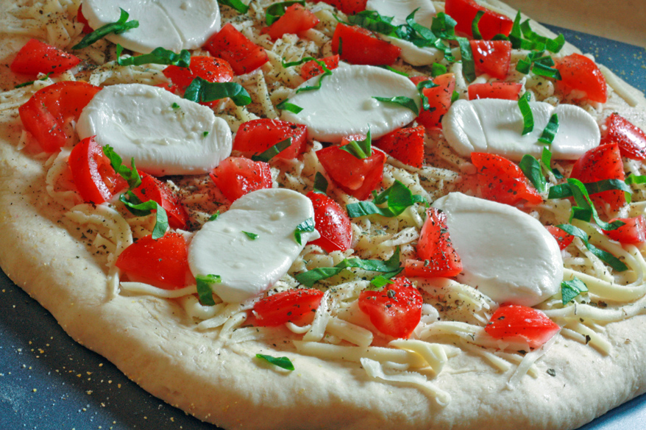
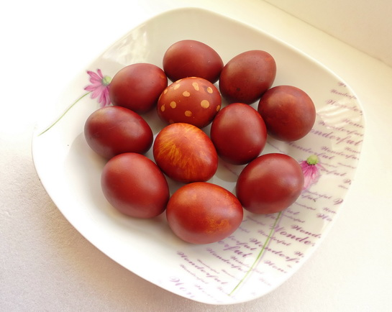
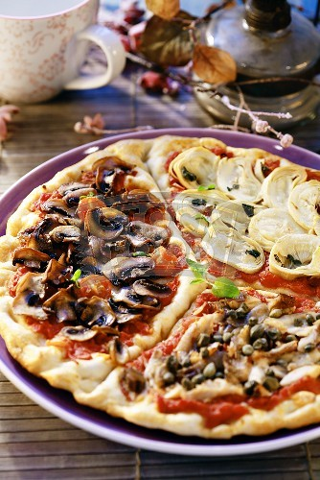
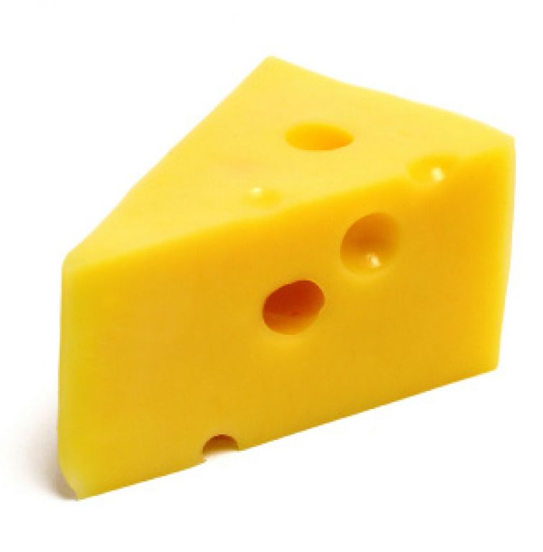
eggs
pizza
cheese
pizza

Slide 6
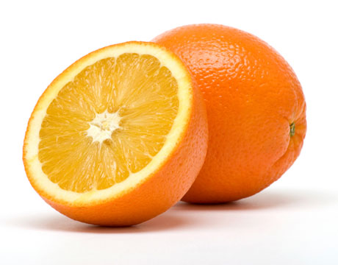
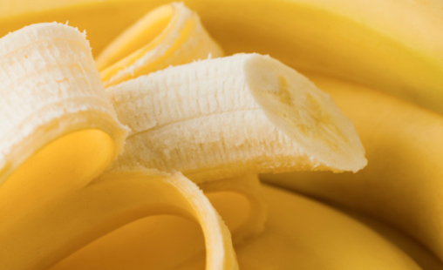
apple
orange
banana
cherry

Slide 7
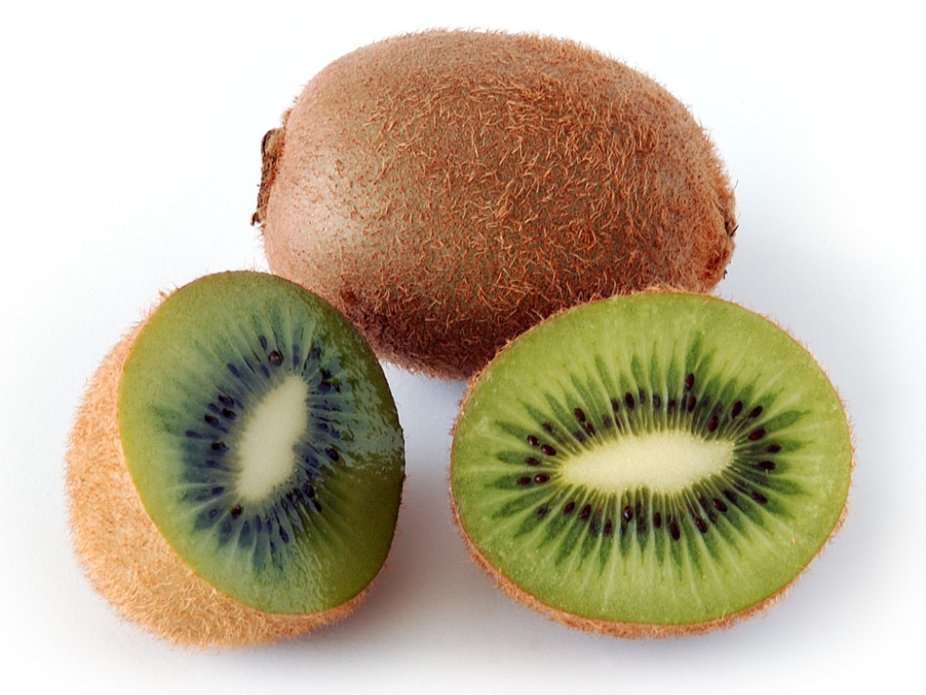
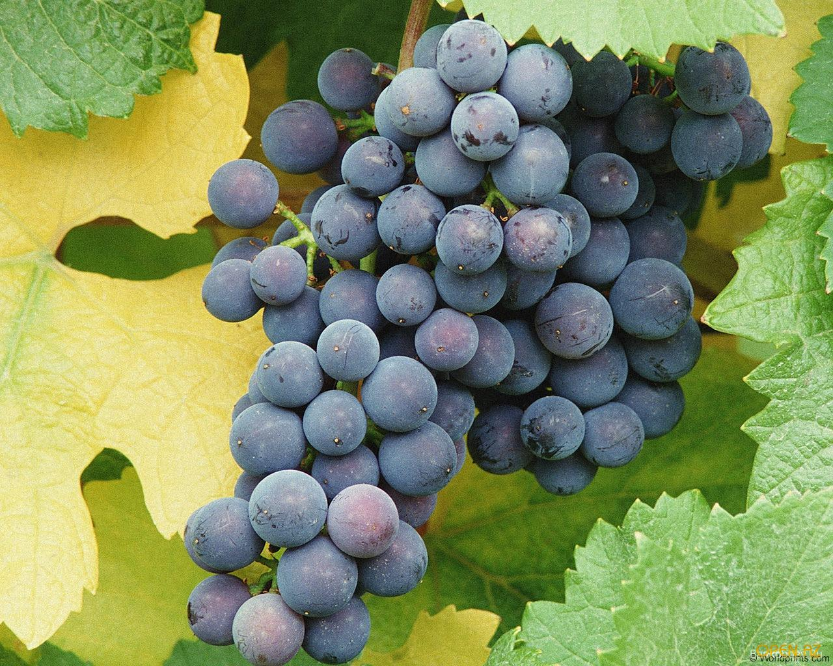
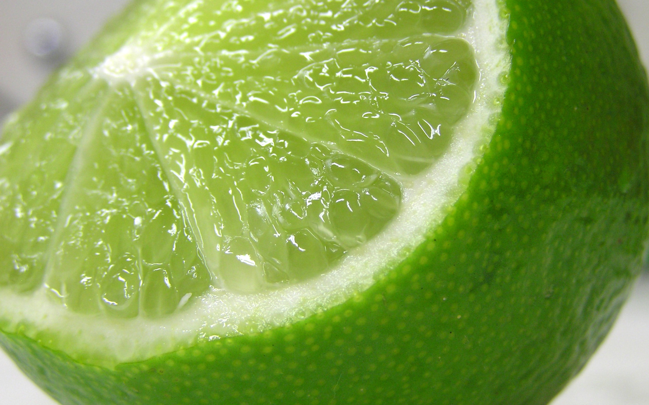
lemon
kiwi
grapes
lime

Slide 8
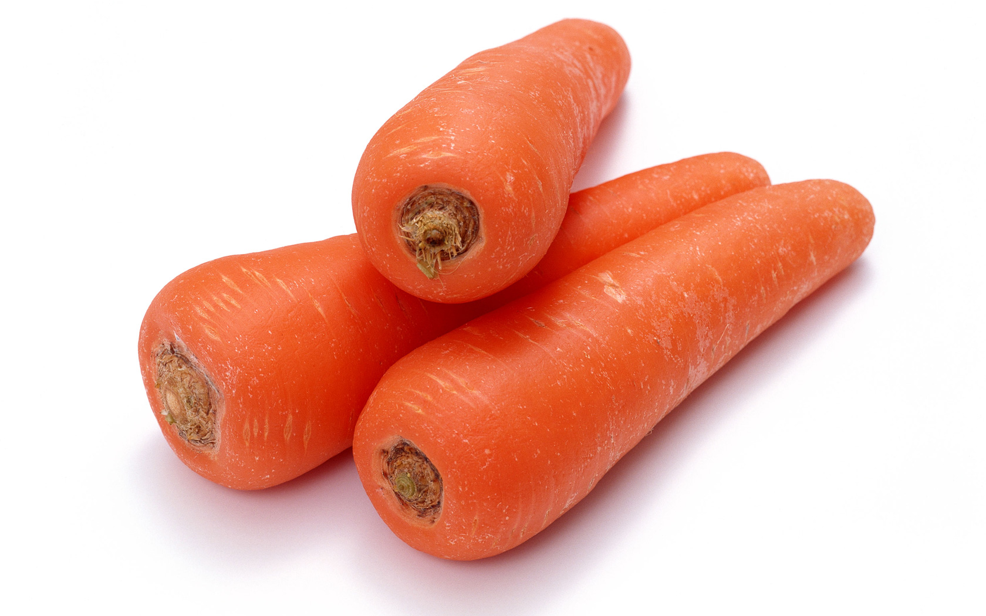
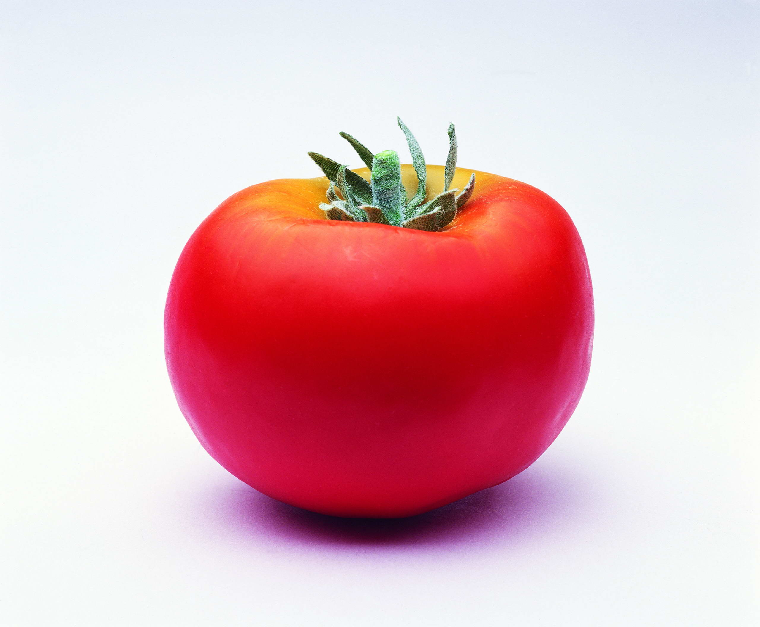
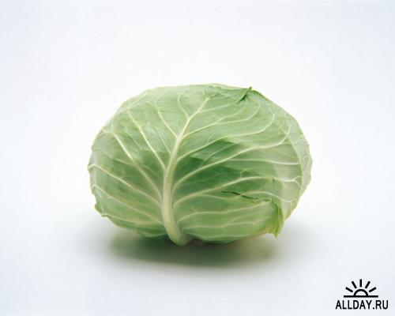
tomato
carrot
cabbage
corn

Slide 9
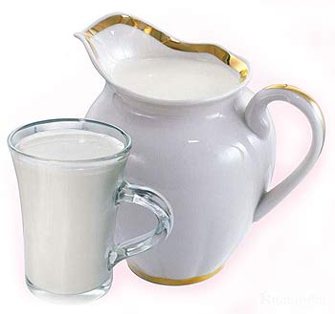
milk
tea
juice
coffee

Slide 10
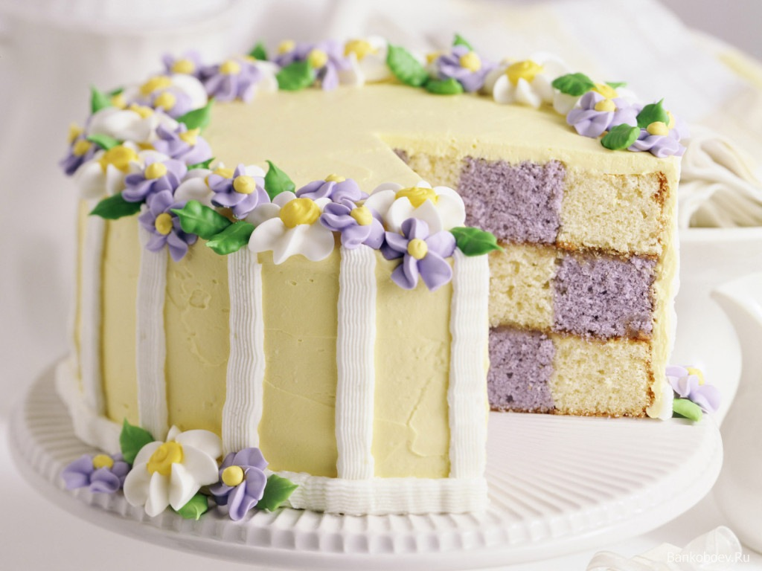
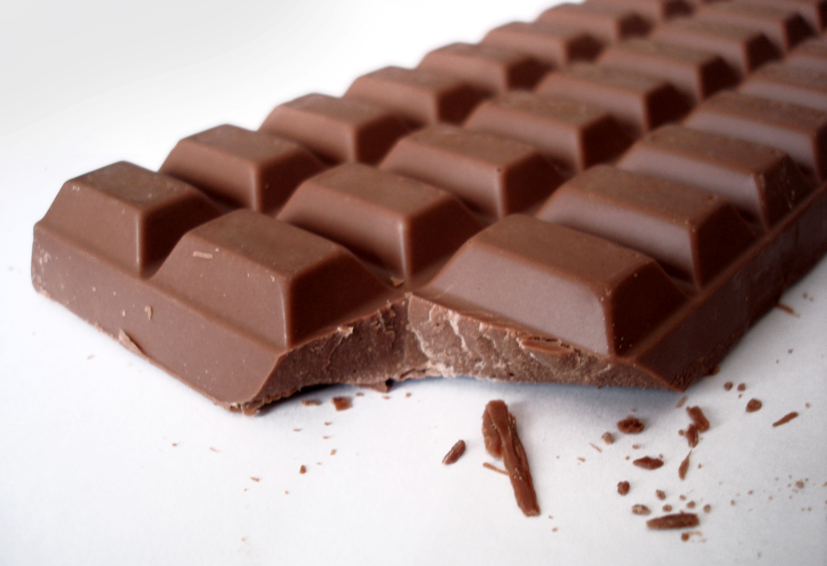
Ice-cream
lollipops
chocolate
cake

Slide 11
 | A | B | C | D | E
1
2
3
4
5

Slide 12
Chicken, bus, fish, hamburger.
Music, honey, sandwich, sweet
Coffee, juice, milk, book.
Ice-cream, chocolate, monkey, cake.

Slide 13
Chicken, bus, fish, hamburger.
Music, honey, sandwich, sweet
Coffee, juice, milk, book.
Ice-cream, chocolate, monkey, cake.

Slide 14
Broccoli

Slide 15
Составьте диалоги, используя фразы:
- Do you like…?
- Yes, I do./ No, I don’t.
- Would you like…..?
Yes, please / No, thank you.
Here you are.
Thank you.

Slide 16
Home task: Imagine that you have your own cafe.
Make a menu for the café.

